Slide 1
Web Design Lecture-2B
Instructor: Vishal Chawla

Slide 2
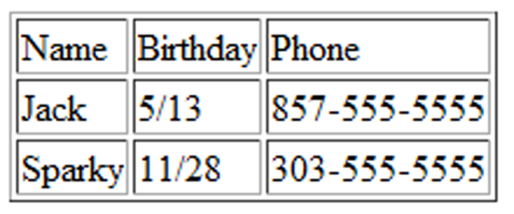
HTML Table
Tables are used on web pages to organize tabular information
Composed of rows and columns – similar to a spreadsheet.
Each individual table cell is at the intersection of a specific row and column.
Configured with table, tr, and td elements
Source: Basics of Web Design (HTML5 and CSS3)

Slide 3
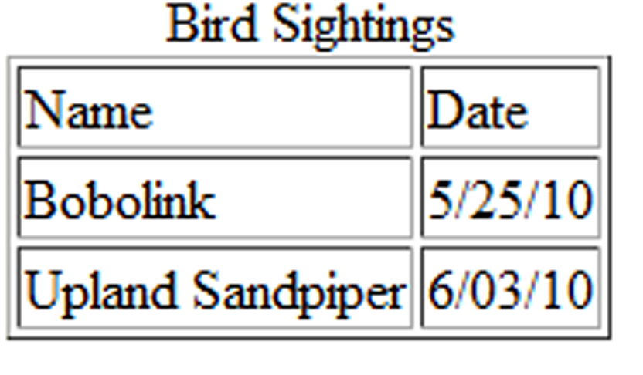
HTML Table Elements
<table> Contains the table
<tr> Contains a table row
<td> Contains a table cell
<caption> Configures a description of the table
Source: Basics of Web Design (HTML5 and CSS3)

Slide 4
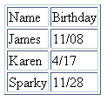
HTML Table Example
<table border="1"> <caption>Birthday List</caption>
<tr>
<td>Name</td>
<td>Birthday</td>
</tr>
<tr>
<td>James</td>
<td>11/08</td>
</tr>
<tr>
<td>Karen</td>
<td>4/17</td>
</tr>
<tr>
<td>Sparky</td>
<td>11/28</td>
</tr>
</table>
Birthday List
Source: Basics of Web Design (HTML5 and CSS3)

Slide 5
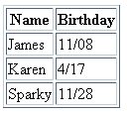
HTML Table Example 2
<table border="1">
<tr>
<th>Name</th>
<th>Birthday</th>
</tr>
<tr>
<td>James</td>
<td>11/08</td>
</tr>
<tr>
<td>Karen</td>
<td>4/17</td>
</tr>
<tr>
<td>Sparky</td>
<td>11/28</td>
</tr>
</table>
Using the <th> Element
Source: Basics of Web Design (HTML5 and CSS3)

Slide 6
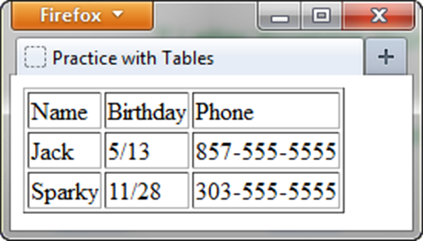
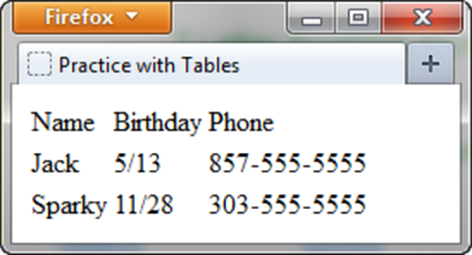
HTML border Attribute
Indicates the table is specifically not used for page layout
Optional
border=“1” Visible browser default border
border=“” No visible browser default border.
Source: Basics of Web Design (HTML5 and CSS3)

Slide 7

HTML colspan Attribute
<table border="1">
<tr>
<td colspan=“2”> Birthday List</td>
</tr>
<tr>
<td>James</td>
<td>11/08</td>
</tr>
<tr>
<td>Karen</td>
<td>4/17</td>
</tr>
</table>
Source: Basics of Web Design (HTML5 and CSS3)

Slide 8
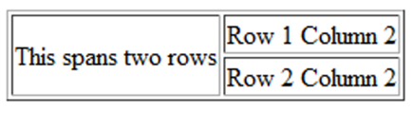
HTML rowspan Attribute
<table border="1"> <tr> <td rowspan="2">This spans two rows</td> <td>Row 1 Column 2</td> </tr> <tr> <td>Row 2 Column 2</td> </tr> </table>
Source: Basics of Web Design (HTML5 and CSS3)

Slide 9
Accessibility and Tables
Use table header elements (<th> tags) to indicate column or row headings.
Use the summary attribute on the table element to provide an overview of the purpose and organization of the table.
Use the caption element to provide the title/caption for the table.
Other attributes that provide for accessibility:
headers & id
scope
Source: Basics of Web Design (HTML5 and CSS3)

Slide 10
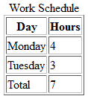
Accessibility: headers & id Attributes
<table>
<caption> Word Schedule</caption>
<tr>
<th id="day">Day</th>
<th id="hours">Hours</th>
</tr>
<tr>
<td headers="day">Monday</td>
<td headers="hours">4</td>
</tr>
<tr>
<td headers="day">Tuesday</td>
<td headers="hours">3</td>
</tr>
<tr>
<td headers="day">Total</td>
<td headers="hours">7</td>
</tr>
</table>
Source: Basics of Web Design (HTML5 and CSS3)

Slide 11
CSS3 Structural Pseudo-classes
Pseudo-class | Purpose
:first-of-type | Applies to the first element of the specified type.
:first-child | Applies to the first child of an element. (CSS2 selector)
:last-of-type | Applies to the last element of the specified type.
:last-child | Applies to the last child of an element
:nth-of-type(n) | Applies to the “nth” element of the specified type. Values: a number, odd, or even
Source: Basics of Web Design (HTML5 and CSS3)

Slide 12
Table Row Groups
<table>
<caption>Work Schedule</caption>
<thead>
<tr>
<th>Day</th>
<th>Hours</th>
</tr>
</thead>
<tbody>
<tr>
<td>Monday</td>
<td>4</td>
</tr>
<tr>
<td>Tuesday</td>
<td>3</td>
</tr>
</tbody>
<tfoot>
<tr>
<td>Total</td>
<td>7</td>
</tr>
</tfoot>
</table>
<thead> table head rows
<tbody > table body rows
<tfoot> table footer rows
Source: Basics of Web Design (HTML5 and CSS3)

